Slide 1
Case Study: Classifying and Analyzing Physical Activities through Heart Rate Variability and Other Physical Metrics Using Holter Monitor Data
Boyan Davidov, Boyan Markov, Simona Mircheva
Notes:
Image by stokpic from Pixabay From <https://pixabay.com/photos/man-jumping-mountains-731900/>

Slide 2


Overview
Zephyr Technology Corporation - BioModule 3.0
Human Activity Recognition
Notes:
Academics and Researchers | Zephyr™ Performance Systems (zephyranywhere.com) Photo from https://www.zephyranywhere.com/ This case study focuses on data derived from a Holter monitor, a device that continuously measures and records heart activity, along with several other physical metrics. A noteworthy feature among the measured metrics is heart rate variability (HRV), which reflects the variation in time intervals between consecutive heartbeats. All data is labeled with the type of physical activities being performed by the individuals wearing the Holter monitors.

Slide 3
Holter Monitor
Physical metrics like heart rate variability, respiratory rate, oxygen saturation and body temperature
Data points annotated with a corresponding physical activity label like running, walking, swimming, cycling, or resting
Human Activity Recognition
Notes:
Academics and Researchers | Zephyr™ Performance Systems (zephyranywhere.com) Photo from https://www.zephyranywhere.com/
The dataset encompasses time-series data collected from Holter monitors, encompassing a range of physical metrics like heart rate variability, respiratory rate, oxygen saturation, and body temperature. Each data point is annotated with a corresponding physical activity label, which could include activities like running, walking, swimming, cycling, or resting. The breadth of these activities provides a good basis for exploring the ways in which these physical metrics respond to different types of exertion.

Slide 4

Goals
Identifying similarities among diverse physical activities using the provided metrics.
Constructing a predictive model capable of accurately categorizing the type of activity based on the recorded data.
Human Activity Recognition
Notes:
Photo by Pixabay: https://www.pexels.com/photo/abstract-accuracy-accurate-aim-262438/ From <https://www.pexels.com/photo/abstract-accuracy-accurate-aim-262438/>
The primary objectives of this case study are twofold: first, to identify and explain similarities among the different types of physical activities based on the given metrics; second, to develop a predictive model that can accurately classify the type of activity given the recorded data.
The tasks for this case study are divided into two parts. The first involves conducting exploratory data analysis to uncover similarities among different physical activities. The focus is on finding patterns and drawing conclusions based on the recorded physical metrics, particularly HRV.
The second task requires creating a predictive model capable of accurately identifying the type of physical activity from the provided Holter monitor data.

Slide 5
Analysis stages
Similarity Analysis
Model Development
Model Evaluation
Human Activity Recognition
Notes:
Photo by Pixabay: https://www.pexels.com/photo/abstract-accuracy-accurate-aim-262438/ From <https://www.pexels.com/photo/abstract-accuracy-accurate-aim-262438/>
Exploratory Data Analysis
Through visualization and statistical methods, we explored the relationships between the different physical metrics and the types of activities. For instance, we plotted the distributions of HRV values for each activity, or calculated the correlation between HRV and other metrics.

Slide 6
Similarity Analysis
In our analysis, we employ clustering techniques such as t-SNE,UMAP and K-means clustering to group physically similar activities based on the recorded metrics.
Human Activity Recognition
Notes:
Photo by Pixabay: https://www.pexels.com/photo/abstract-accuracy-accurate-aim-262438/ From <https://www.pexels.com/photo/abstract-accuracy-accurate-aim-262438/>
Similarity Analysis
We employed clustering techniques such as t-SNE, UMAP and K-means clustering to group together similar physical activities based on the recorded metrics. The results will be interpreted to understand the characteristics shared among activities within the same cluster.

Slide 7
Model Development
For the development of our predictive model, we explore various machine learning algorithms. These models undergo rigorous evaluation using methods like cross-validation and hyperparameter tuning to ensure robustness and accuracy.
Human Activity Recognition
Notes:
Photo by Pixabay: https://www.pexels.com/photo/abstract-accuracy-accurate-aim-262438/ From <https://www.pexels.com/photo/abstract-accuracy-accurate-aim-262438/>
Model Development
We experimented with several machine learning algorithms to develop a predictive model. These models will be evaluated using techniques such as cross-validation and hyperparameter tuning.

Slide 8
Model Evaluation
To gauge the effectiveness of our models in classifying physical activities, we will assess them using performance metrics including precision, recall, F1-score, and accuracy.
Human Activity Recognition
Notes:
Photo by Pixabay: https://www.pexels.com/photo/abstract-accuracy-accurate-aim-262438/ From <https://www.pexels.com/photo/abstract-accuracy-accurate-aim-262438/>
Model Evaluation
The models were assessed based on their ability to correctly classify the physical activities. Metrics such as precision, recall, F1-score, and accuracy were calculated for a comprehensive understanding of model performance.

Slide 9

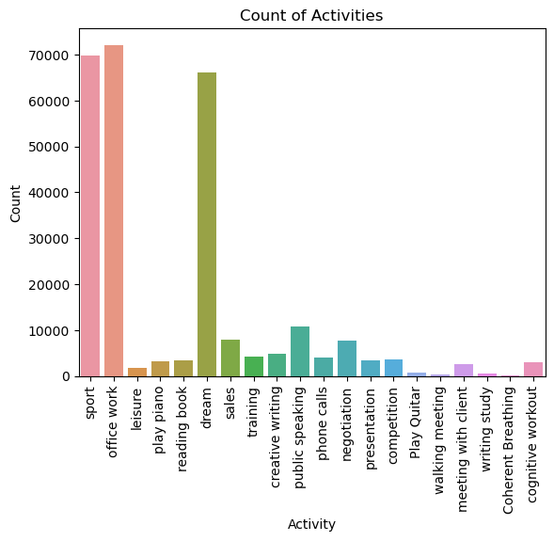
Data Exploration
Labeled data covering 21 physical metrics
Human Activity Recognition
Notes:
Photo by cottonbro studio: https://www.pexels.com/photo/man-with-binary-code-projected-on-his-face-5474028/
From <https://www.pexels.com/photo/man-with-binary-code-projected-on-his-face-5474028/>

Slide 10
Data Exploration
Labeled data covering 21 physical metrics
Severely imbalanced dataset with overrepresented classes
Human Activity Recognition
Notes:
Photo by cottonbro studio: https://www.pexels.com/photo/man-with-binary-code-projected-on-his-face-5474028/
From <https://www.pexels.com/photo/man-with-binary-code-projected-on-his-face-5474028/>

Slide 11
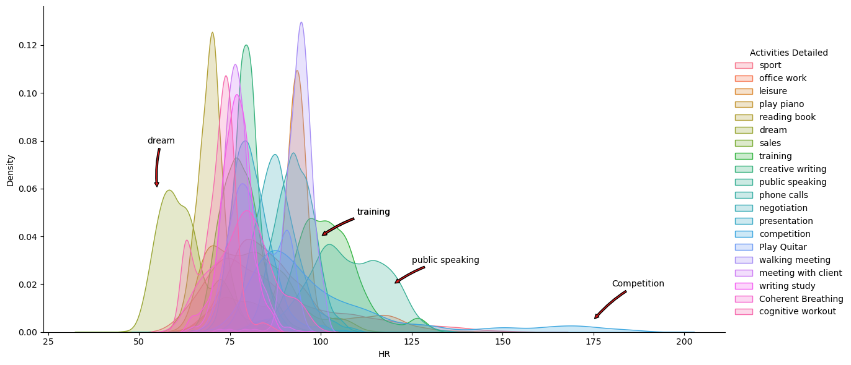
Data Exploration
Noteworthy features among the measured metrics are heart rate (HR) and heart rate variability (HRV), which reflects the variation in time intervals between consecutive heartbeats.
Human Activity Recognition
Notes:
Values consistently above 200+ bpm indicate a noisy ECG signal. Causes include: • Dry sensor pads or skin • Loose strap • Poorly located strap • Poor device/receptacle connection • Device or strap fault Dropouts to 0 usually indicate a mechanical connection problem • Check connection between device and receptacle – handle spring contacts carefully to avoid breaking them Raw ECG data is filtered to account for false or missed R detections, and some smoothing is applied. HR is determined mainly from the preceding 15 seconds of ECG data. The HR detection algorithm initializes at 65bpm. This may show at the beginning of a log for 7 seconds, but be invalid, as the algorithm processes initial data. A flag in the Status Info channel in the Summary Log will indicate whether the HR data is valid.

Slide 12
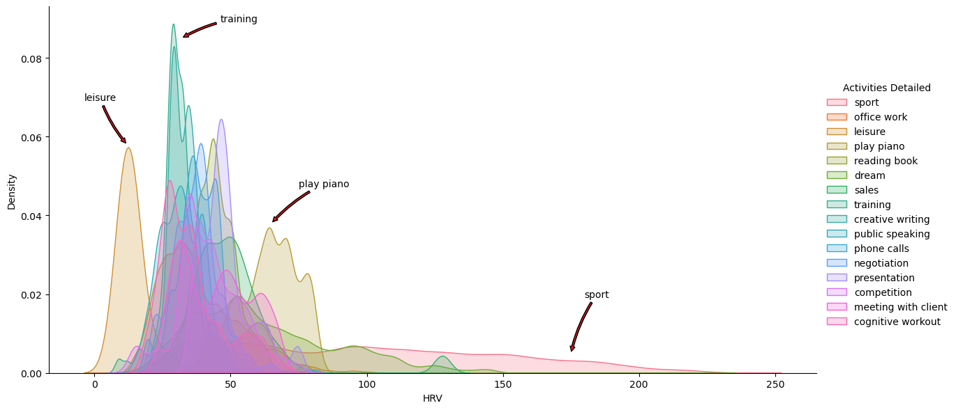
Data Exploration
Noteworthy features among the measured metrics are heart rate (HR) and heart rate variability (HRV), which reflects the variation in time intervals between consecutive heartbeats.
Human Activity Recognition
Notes:
What is Heart Rate Variability and How Can You Improve It? — AIM Human Performance
Our heart beat is not regular like the ticking of clock beating once every second. A healthy heart beat is irregular (see the picture). This irregularity is desirable and an indicator of how ready the body is to adapt to stress. This stress could be bad like a fight with your boss or good like a promotion. When HRV is high, you can handle the incoming stress. When HRV is low you are less adaptable and less able to handle the stress.
Heart rate variability, or HRV for short, is a measure of your autonomic nervous system that is widely considered one of the best objective metrics for physical fitness and determining your body’s readiness to perform. Heart rate variability is literally the variance in time between the beats of your heart. So, if your heart rate is 60 beats per minute, it’s not actually beating once every second. Within that minute there may be 0.9 seconds between two beats, for example, and 1.15 seconds between two others. The greater this variability is, the more “ready” your body is to execute at a high level.

Slide 13
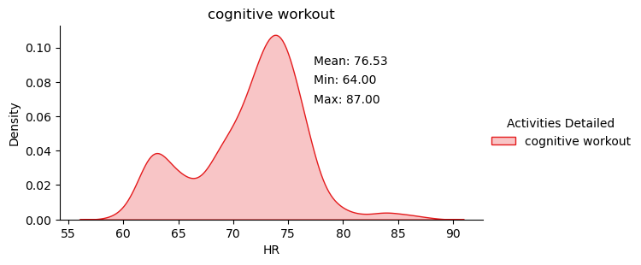
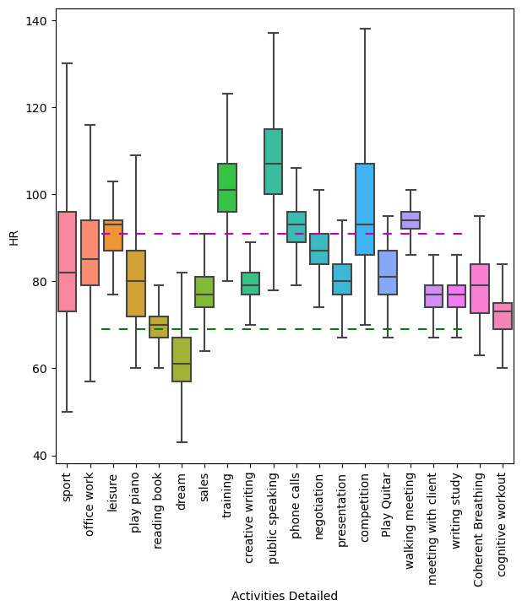
Data Exploration
The features are rarely normally distributed, with many observations in the 3rd quartile.
Human Activity Recognition

Slide 14
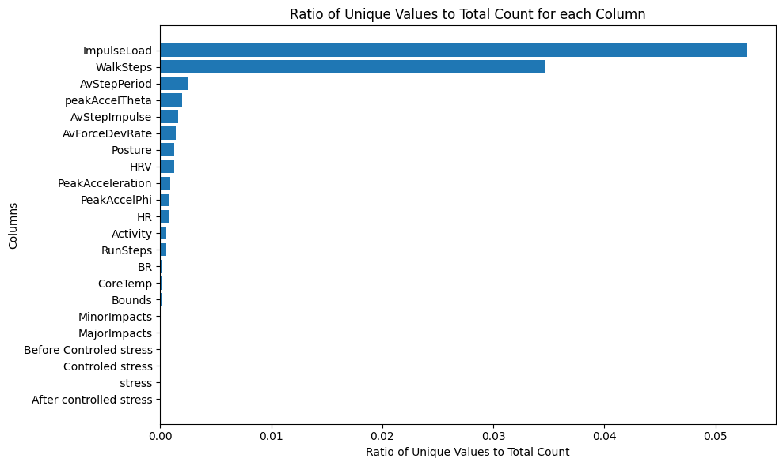
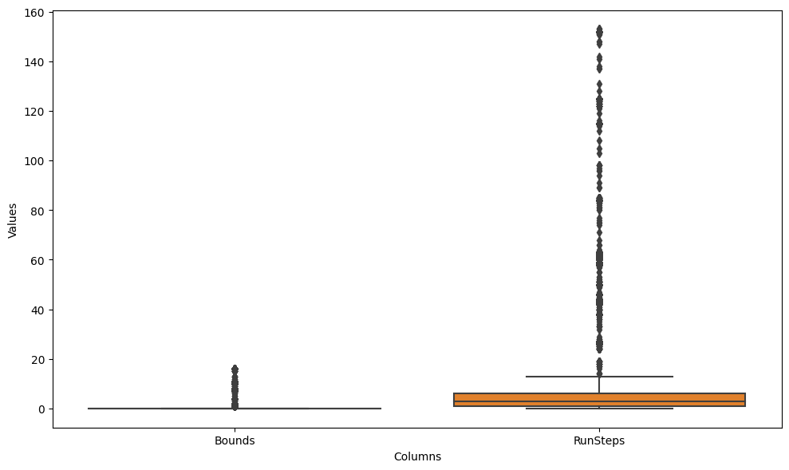
Data Exploration
Distinctiveness of the dataset is relatively low
Some features are quasi binary
Human Activity Recognition

Slide 15
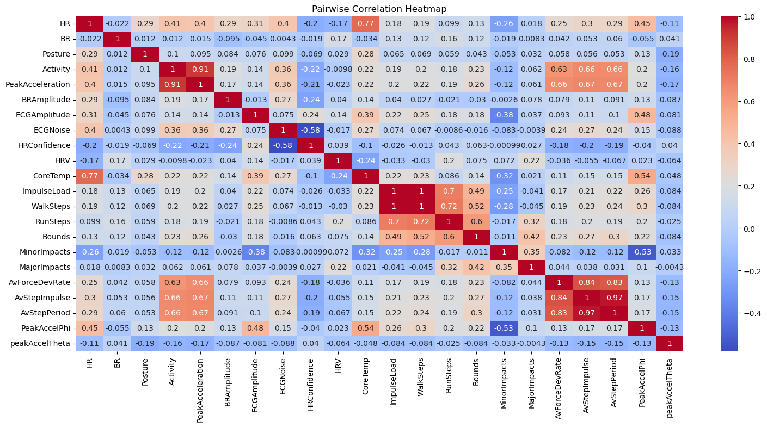
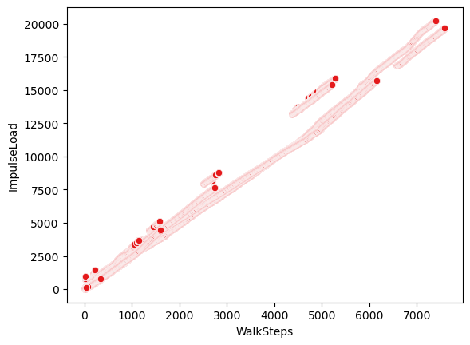
Dimensionality Reduction
Some of the features were highly correlated (linearly), implying redundancy of features
Human Activity Recognition
Notes:
From the correlation matrix we can see that following features are highly correlated
'Activity','PeakAcceleration' - we leave only 'Activity'
'ECGNoise' and 'HRConfidence' - we leave only 'ECGNoise'
'ImpulseLoad', 'WalkSteps','RunSteps','Bounds' - we leave only 'ImpulseLoad'
'AvForceDevRate','AvStepImpulse','AvStepPeriod' - we leave only 'AvForceDevRate'
'CoreTemp' and 'HR' - we leave only 'HR'
'MinorImpacts' with 'PeakAccelPhi' - we leave only 'PeakAccelPhi'
Therefore,following columns can be deleted: 'PeakAcceleration','HRConfidence','AvForceDevRate','AvStepImpulse','WalkSteps','RunSteps','Bounds','CoreTemp', 'MinorImpacts', 'MajorImpacts'

Slide 16

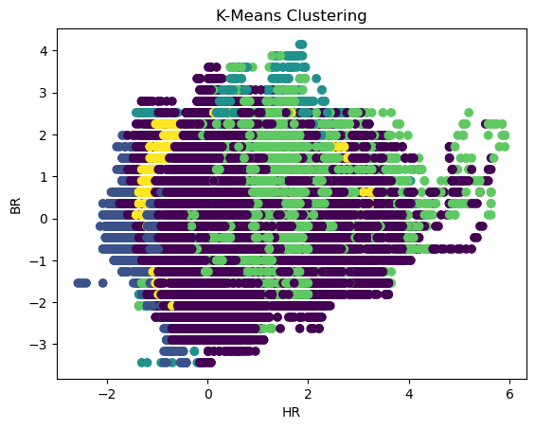
Dimensionality Reduction
We attempted first to reduce dimensionality via PCA, however, to achieve >80% explained variance we needed 8 components
K-means clustering alone was not able to draw clear boundaries
Human Activity Recognition
Notes:
Photo by Tima Miroshnichenko: https://www.pexels.com/photo/a-person-holding-a-smartphone-7567228/
From <https://www.pexels.com/photo/a-person-holding-a-smartphone-7567228/>
Principal component analysis, or PCA, is a statistical procedure that allows you to summarize the information content in large data tables by means of a smaller set of “summary indices” that can be more easily visualized and analyzed.
Principal component analysis is a popular technique for analyzing large datasets containing a high number of dimensions/features per observation, increasing the interpretability of data while preserving the maximum amount of information, and enabling the visualization of multidimensional data.
It turned out that we need 8 components to explain 80% of the variance in the data. This is not very promising. There are too many interesecting points. It is clear that we need to find alternative way to clusterize the data.

Slide 17
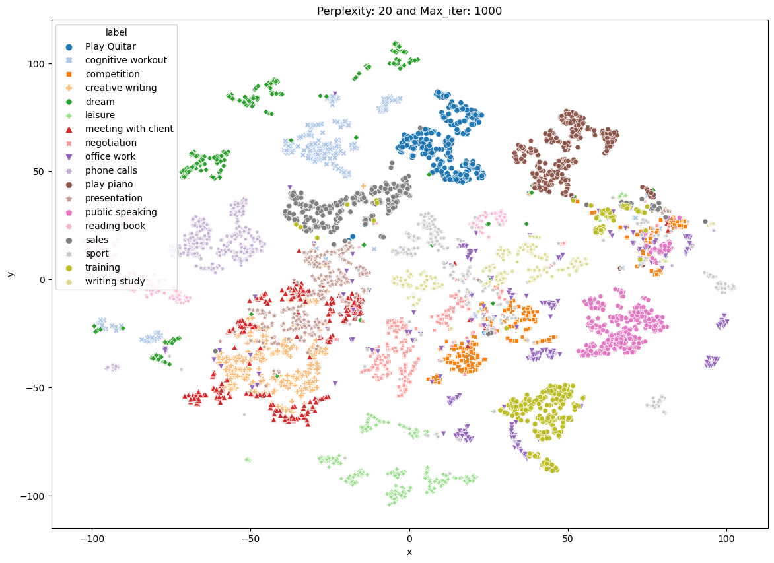
Similarity Analysis
t-SNE (t-distributed stochastic neighbour embedding) was able to separate them nicely although not perfectly
t-SNE is a nonlinear dimensionality reduction technique which retains local variance (PCA → global variance)
Human Activity Recognition
Notes:
Photo by Tima Miroshnichenko: https://www.pexels.com/photo/a-person-holding-a-smartphone-7567228/
From <https://www.pexels.com/photo/a-person-holding-a-smartphone-7567228/>
t-distributed stochastic neighbor embedding is a statistical method for visualizing high-dimensional data by giving each datapoint a location in a two or three-dimensional map. PCA preserves the variance in the data, whereas t-SNE preserves the relationships between data points in a lower-dimensional space, making it quite a good algorithm for visualizing complex high-dimensional data.
Both t-SNE and PCA are dimensional reduction techniques that have different mechanisms and work best with different types of data.
PCA (Principal Component Analysis) is a linear technique that works best with data that has a linear structure. It seeks to identify the underlying principal components in the data by projecting onto lower dimensions, minimizing variance, and preserving large pairwise distances.
But, t-SNE is a nonlinear technique that focuses on preserving the pairwise similarities between data points in a lower-dimensional space. t-SNE is concerned with preserving small pairwise distances whereas, PCA focuses on maintaining large pairwise distances to maximize variance.
t-SNE is a powerful visualization tool for revealing hidden patterns and structures in complex datasets. You can use it for images, audio, biologicals, and single data to identify anomalies and patterns.
t-SNE, a popular dimensionality reduction technique that can visualize high-dimensional non-linear data in a low-dimensional space.
Local structure is preserved when local neighborhoods in the high-dimensional space are similar to local neighborhoods in the low-dimensional space. Global structure preservation means that relative positions between clusters are preserved, as well as larger-scale manifold structures.
Perplexity: It is roughly the number of neighbours which are required to be preserved while altering dimensions.
· Low perplexity: Results are ambiguous and not useful.
· Increases gradually: Results improve and certain stability is achieved in the embedding structure.
· High Perplexity (greater than # of samples): messy plot, cannot provide insights

Slide 18
Similarity Analysis
Certain degree of class mixing might be unavoidable
Shortcoming - t-SNE doesn’t inherently define decision boundaries (i.e. you need to perform additionally some clustering)
Perplexity(P) needs to be defined by the user (the larger the P the more data points are included in the neighbourhood)
Human Activity Recognition
Notes:
Photo by Tima Miroshnichenko: https://www.pexels.com/photo/a-person-holding-a-smartphone-7567228/
From <https://www.pexels.com/photo/a-person-holding-a-smartphone-7567228/>
Looking at the t-SNE representation of clusters one cannot conclude anything about the cluster size or even the distance between the clusters (t-SNE does not preserve the distance between different neighbourhoods)
t-SNE cannot be used to interpret cluster size and intra-cluster distances.

Slide 19
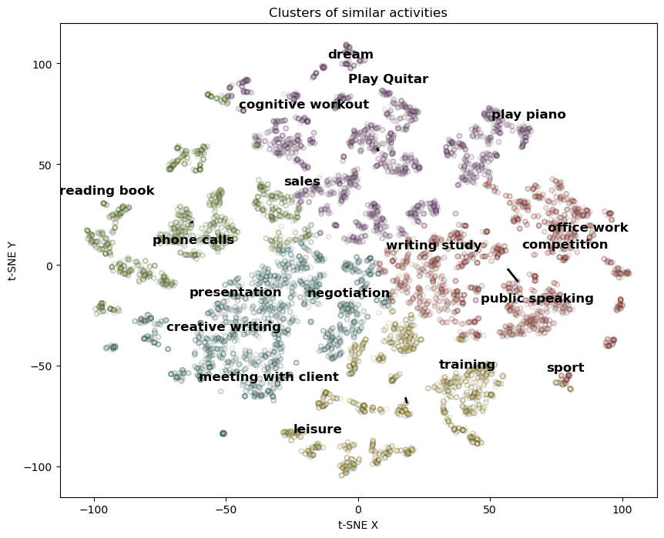
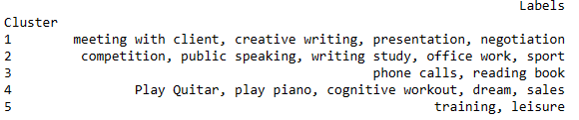
Similarity Analysis
T-SNE
Human Activity Recognition
Notes:
Photo by Tima Miroshnichenko: https://www.pexels.com/photo/a-person-holding-a-smartphone-7567228/
From <https://www.pexels.com/photo/a-person-holding-a-smartphone-7567228/>

Slide 20

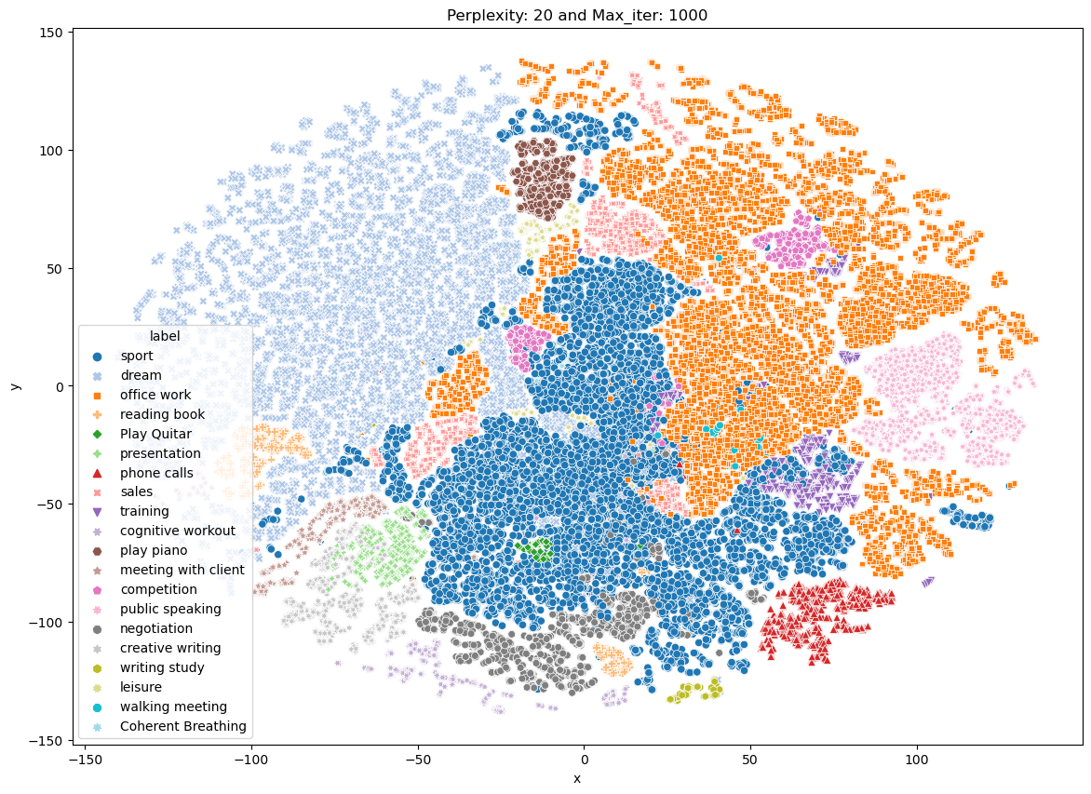
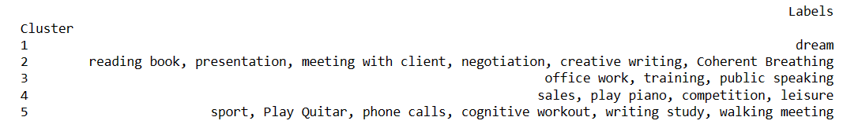
Similarity Analysis
Human Activity Recognition
Notes:
Photo by Tima Miroshnichenko: https://www.pexels.com/photo/a-person-holding-a-smartphone-7567228/
From <https://www.pexels.com/photo/a-person-holding-a-smartphone-7567228/>

Slide 21
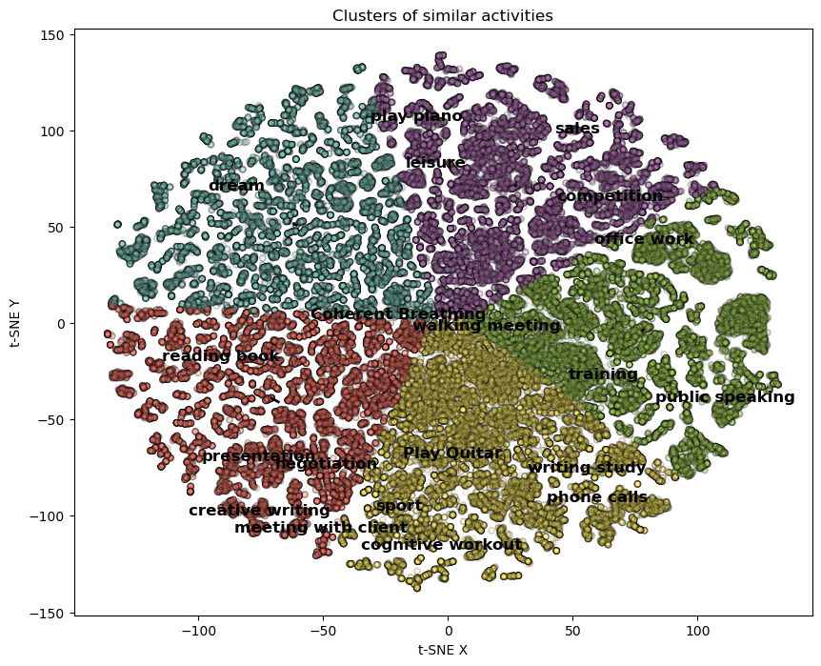
Similarity Analysis
T-SNE
Human Activity Recognition
Notes:
Photo by Tima Miroshnichenko: https://www.pexels.com/photo/a-person-holding-a-smartphone-7567228/
From <https://www.pexels.com/photo/a-person-holding-a-smartphone-7567228/>
t-SNE and UMAP are both non-linear, graph-based methods for dimensionality reduction
t-SNE and UMAP have the same principle and workflow: create a high dimensional graph, then reconstruct it in a lower dimensional space while retaining the structure
t-SNE moves the high dimensional graph to a lower dimensional space points by points. UMAP compresses that graph
They face the same problem: the “distance” must be constrained, otherwise cells will be all connected or isolated. This is the Curse of Dimensionality where data points are so sparse. The constraint is put on the number of neighbors that a cell can pick.
For t-SNE the parameter to control is the perplexity. For UMAP, it’s the number of neighbors (n_neighbor). The two parameters are what we should take care of when optimizing our data visualization.

Slide 22
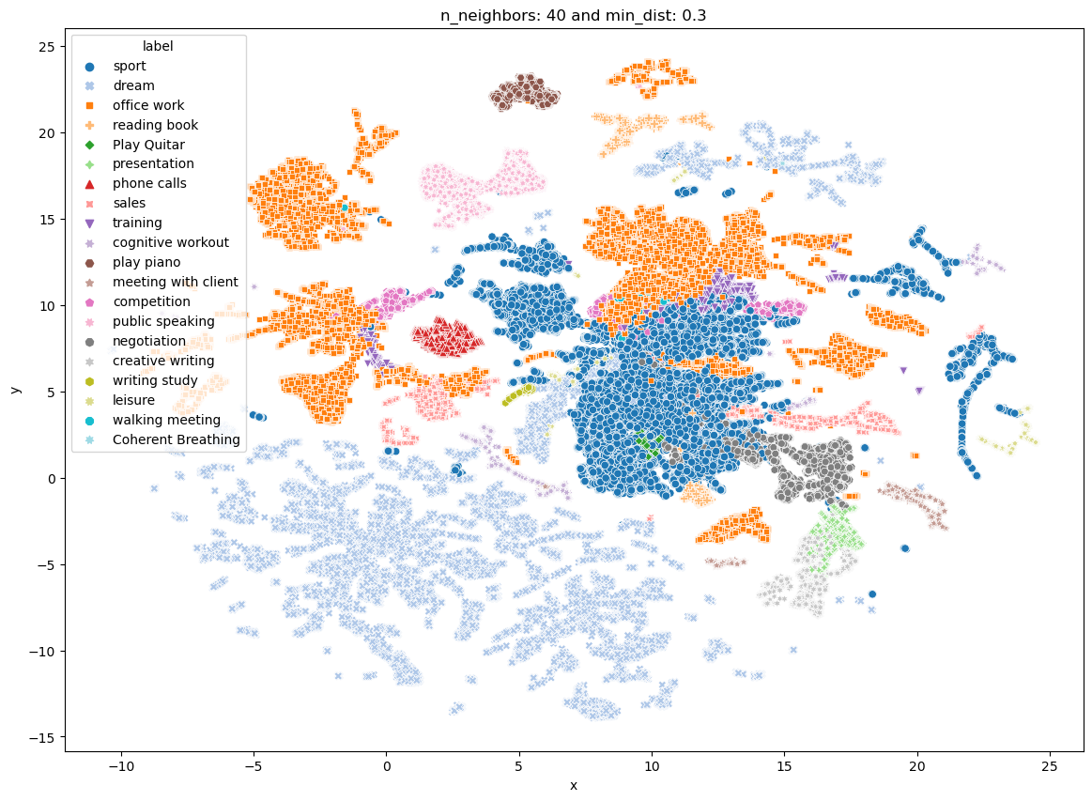
Similarity Analysis
UMAP: (Uniform Manifold Approximation and Projection) is similar to t-SNE but much faster
UMAP constructs a high-dimensional weighted k-neighbour graph representation of the original data X
Human Activity Recognition
Notes:
Photo by Tima Miroshnichenko: https://www.pexels.com/photo/a-person-holding-a-smartphone-7567228/
From <https://www.pexels.com/photo/a-person-holding-a-smartphone-7567228/>
t-SNE and UMAP have the same principle and workflow: create a high dimensional graph, then reconstruct it in a lower dimensional space while retaining the structure. t-SNE moves the high dimensional graph to a lower dimensional space points by points. UMAP compresses that graph.
While both algorithms exhibit strong local clustering and group similar categories together, UMAP much more clearly separates these groups of similar categories from each other.

Slide 23
Similarity Analysis
User must choose radius (min_dist) - too small a choice will lead to small, isolated clusters, while too large a choice will connect everything together
Human Activity Recognition
Notes:
Photo by Tima Miroshnichenko: https://www.pexels.com/photo/a-person-holding-a-smartphone-7567228/
From <https://www.pexels.com/photo/a-person-holding-a-smartphone-7567228/>
Dimensionality reduction is a powerful tool for machine learning practitioners to visualize and understand large, high dimensional datasets. One of the most widely used techniques for visualization is t-SNE, but its performance suffers with large datasets and using it correctly can be challenging.
UMAP is a new technique by McInnes et al. that offers a number of advantages over t-SNE, most notably increased speed and better preservation of the data's global structure.
UMAP is fast, scaling well in terms of both dataset size and dimensionality. For example, UMAP can project the 784-dimensional, 70,000-point MNIST dataset in less than 3 minutes, compared to 45 minutes for scikit-learn's t-SNE implementation. Additionally, UMAP tends to better preserve the global structure of the data.
While both algorithms exhibit strong local clustering and group similar categories together, UMAP much more clearly separates these groups of similar categories from each other.

Slide 24
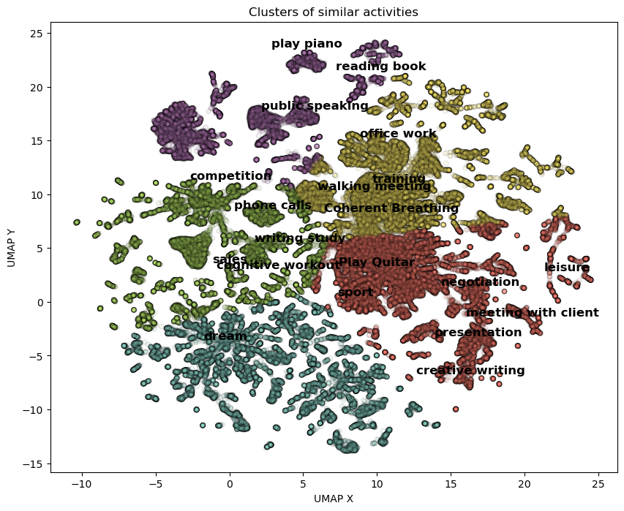
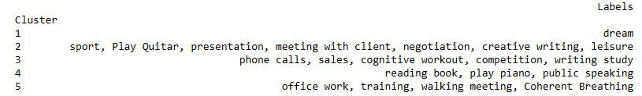
Similarity Analysis
UMAP
Human Activity Recognition
Notes:
Photo by Tima Miroshnichenko: https://www.pexels.com/photo/a-person-holding-a-smartphone-7567228/
From <https://www.pexels.com/photo/a-person-holding-a-smartphone-7567228/>

Slide 25
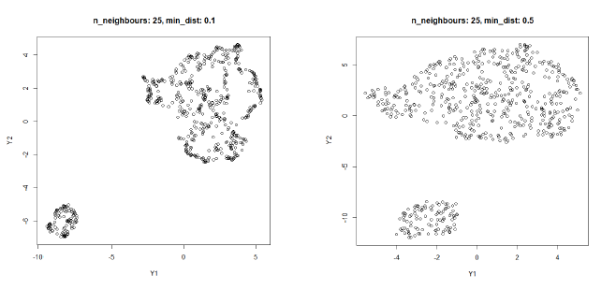
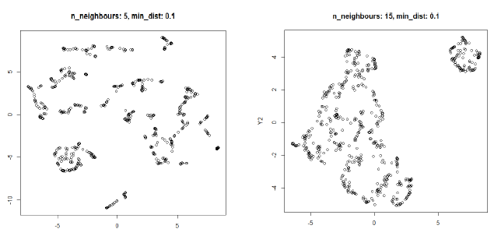
Caveats when using UMAP or t-SNE
Crowding problems
Hyperparameters
Random initialization
Human Activity Recognition
Notes:
Photo by Tima Miroshnichenko: https://www.pexels.com/photo/a-person-holding-a-smartphone-7567228/
From <https://www.pexels.com/photo/a-person-holding-a-smartphone-7567228/>
t-SNE tends to suffer from "overcrowding"
All clusters get clumped together (the exact reason for this is not very clear) and the only known way to counter-balance
UMAP pull clusters much further apart
Hyperparameters really matter
Choosing good values isn't easy, and depends on both the data and your goals (eg, how tightly packed the projection ought to be). This is where UMAP's speed is a big advantage - By running UMAP multiple times with a variety of hyperparameters, you can get a better sense of how the projection is affected by its parameters.
n_neighbors - the number of approximate nearest neighbors used to construct the initial high-dimensional graph. It effectively controls how UMAP balances local versus global structure - low values will push UMAP to focus more on local structure by constraining the number of neighboring points considered when analyzing the data in high dimensions, while high values will push UMAP towards representing the big-picture structure while losing fine detail
min_dist, or the minimum distance between points in low-dimensional space. This parameter controls how tightly UMAP clumps points together, with low values leading to more tightly packed embeddings. Larger values of min_dist will make UMAP pack points together more loosely, focusing instead on the preservation of the broad topological structure.
A method often recommended for initialization in t-SNE is principal component analysis (PCA)
t-SNE and UMAP with random initialization perform similarly poorly, whereas t-SNE and UMAP with PCA and Laplacian eigenmaps initialization, respectively, perform similarly well
Cluster sizes in a UMAP plot mean nothing
Just as in t-SNE, the size of clusters relative to each other is essentially meaningless. This is because UMAP uses local notions of distance to construct its high-dimensional graph representation.
Distances between clusters might not mean anything
Likewise, the distances between clusters is likely to be meaningless. While it's true that the global positions of clusters are better preserved in UMAP, the distances between them are not meaningful. Again, this is due to using local distances when constructing the graph.
Random noise doesn’t always look random.
Especially at low values of n_neighbors, spurious clustering can be observed.
You may need more than one plot
Since the UMAP algorithm is stochastic (property of being well described by a random probability distribution - Stochastic is synonymous with "random.") , different runs with the same hyperparameters can yield different results. Additionally, since the choice of hyperparameters is so important, it can be very useful to run the projection multiple times with various hyperparameters.

Slide 26
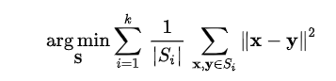
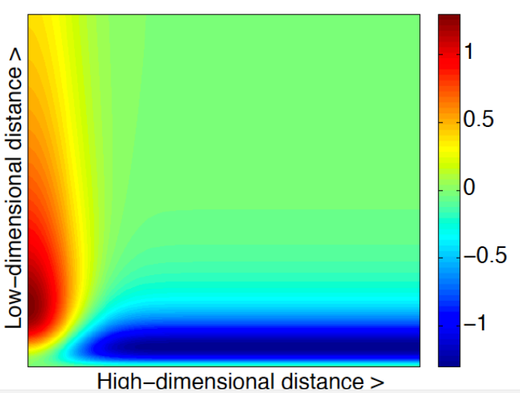
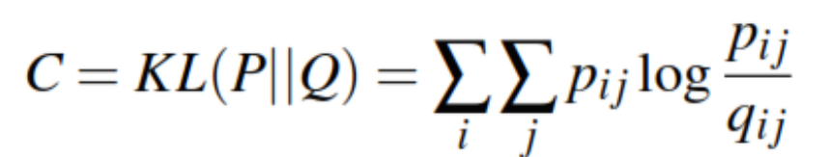
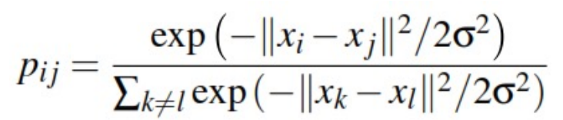
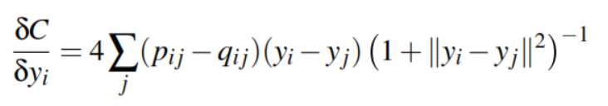
Why does it work
K-means clustering:
How can we measure how close the distributions of X and Y are? -> Kullback–Leibler Divergence
Human Activity Recognition
Gradient descent rationale
Notes:
Photo by Tima Miroshnichenko: https://www.pexels.com/photo/a-person-holding-a-smartphone-7567228/
From <https://www.pexels.com/photo/a-person-holding-a-smartphone-7567228/>

Slide 27
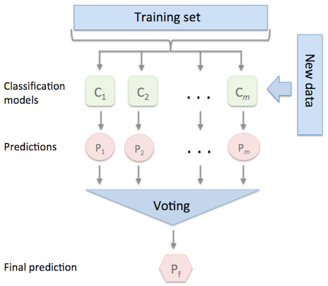
Predictive Model
Human Activity Recognition
Notes:
Photo by Tima Miroshnichenko: https://www.pexels.com/photo/a-person-holding-a-smartphone-7567228/
From <https://www.pexels.com/photo/a-person-holding-a-smartphone-7567228/>

Slide 28
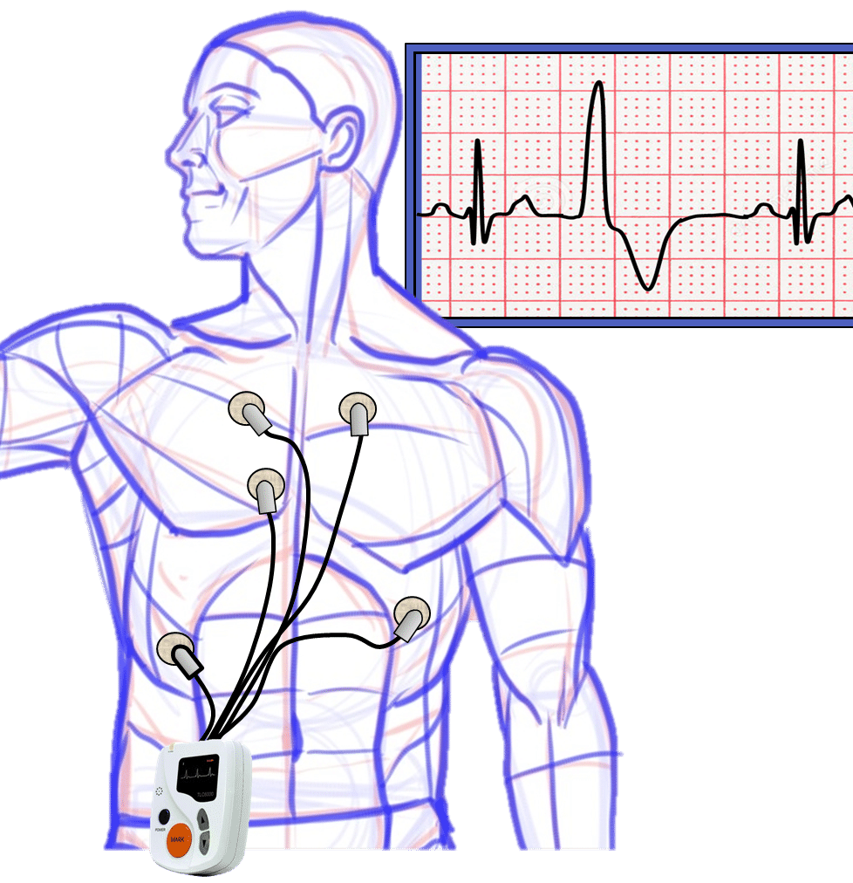
Classifying User Activity via Holter Monitor Data Features
Preliminary Observations:
Distinct clustering patterns within Holter data suggest the feasibility of modeling user activity types.
By harnessing the power of these distinct clustering patterns within Holter data for precise activity classification, we stand at the precipice of a paradigm shift in cardiac health research. This approach not only offers a novel methodology for understanding the intricate relationship between cardiac patterns and physical activity but also sets the stage for a new era of personalized medicine.
Such advancements promise to refine our current knowledge, challenge prevailing notions, and ultimately contribute to the broader scientific discourse on the nexus of physical activity and cardiac health
Human Activity Recognition

Slide 29
Classification of User Activity Types Using Holter Data Features Data Collection and Preprocessing
Model definition
Data Collection
Data Exploration
Use case formulation
Model inception
Human Activity Recognition
Data Split
Outlier Treatment
Data Cleaning
Model
creation
Data Scaler
Model Ensembler
Residuals Analysis

Slide 30
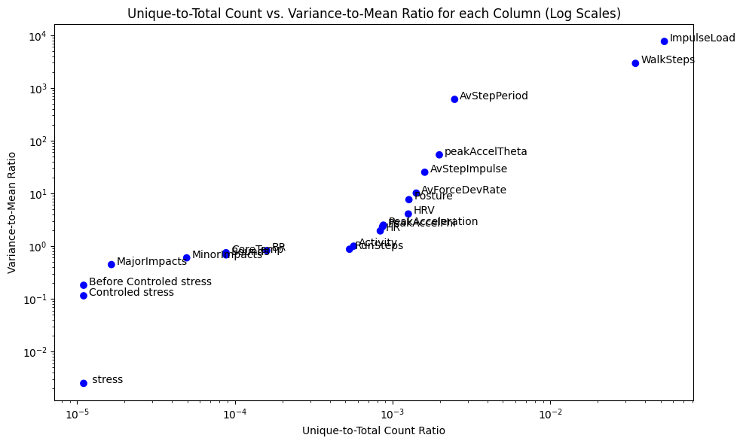

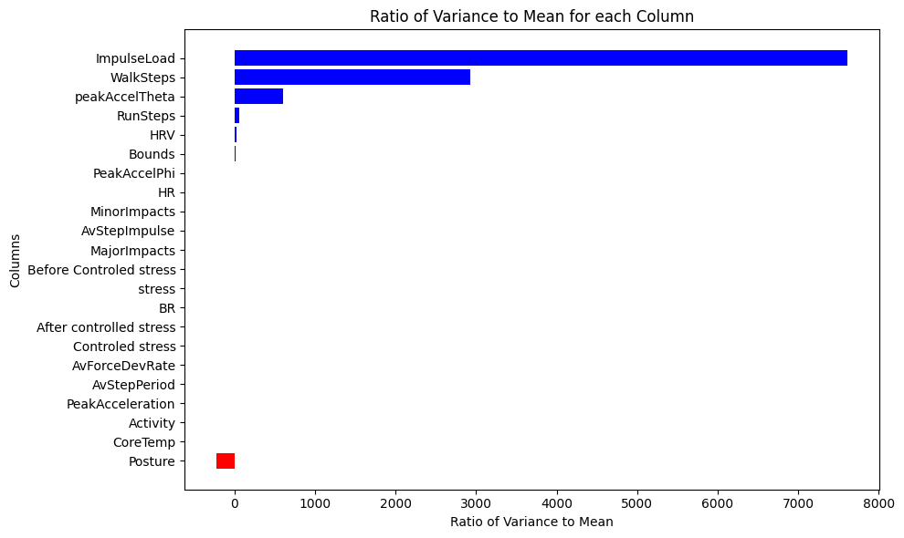
Data Еxploration: Variance in Multiclass Classification
Human Activity Recognition

Slide 31
Data Reduction: A Critical Examination
Temporal Variables (Year, Month, Weekday, Time, Time_New, Date, Hour):
The model exhibited a propensity to overfit based on the temporal sequence of activities (due to low data scale and variability). By removing these variables, we mitigate the risk of the model merely memorizing when specific activities occurred, rather than discerning patterns based on the inherent characteristics of the data.
Holter Machine Health KPIs (BRAmplitude, ECGAmplitude, HRConfidence):
These metrics reflect the operational health and reliability of the Holter machine. They are invariant to the type of activity being performed, making them extraneous for the purpose of activity classification.
Machine Operational Metrics (ECGNoise, Jumps, JumpFlightTime):
These metrics gauge the machine's operational status and its ability to detect noise. Given that the primary objective is to model user activity, these metrics, which pertain more to the machine's functionality, were deemed non-essential.
Manually Inputted Stress Metrics (e.g., Controled stress, stress, etc.):
These metrics, being manually inputted, introduce a subjective element. While they could offer insights into the user's state, their manual nature could introduce variability that might confound the model's predictions. These wouldn’t be available without user input.
Human Activity Recognition

Slide 32
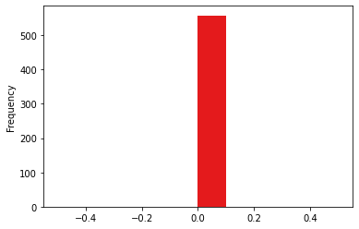

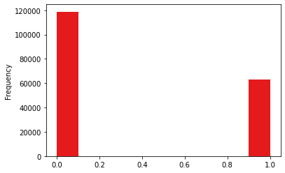
Feature Engineering: Aggregating Sparse Indicators
Objective
Transform columns dominated by zeros, interspersed with sporadic non-zero values, into a streamlined representation.
Approach
Identification: Selected columns with predominantly zero values.
Transformation: Any non-zero entry was marked as 1, encapsulating the presence of activity.
Consolidation: Generated a unified column indicating activity presence across the selected columns.
Optimization: Original columns were discarded, retaining our concise indicator.
Utility
This method offers a distilled view, enabling swift comprehension of activity patterns.
Major / Minor Impacts transformation
Human Activity Recognition

Slide 33
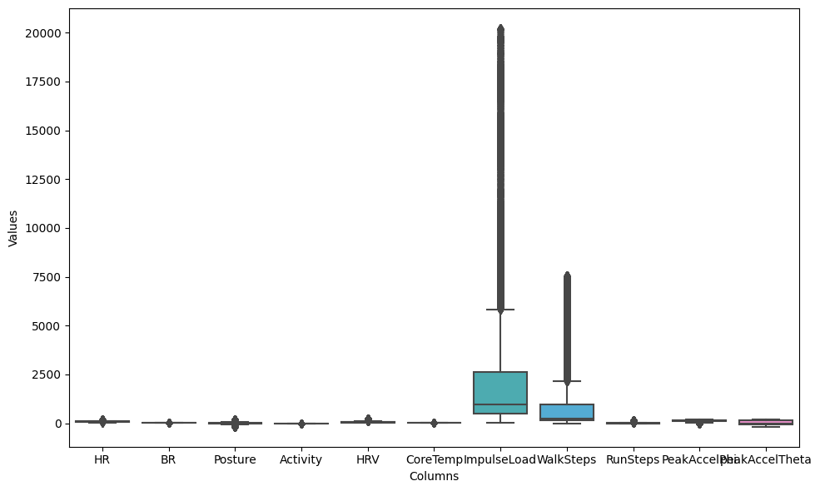
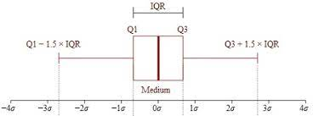
Comprehensive Outlier Reduction Using IQR (numeric)
Methodology
Interquartile Range (IQR) Computation: For each specified column, calculate the 1st (Q1) and 3rd quartiles (Q3). Determine the IQR as the difference between Q3 and Q1.
Outlier Boundaries
Establish boundaries for outliers using the Q1 and Q3
Outlier Detection
Identify data points outside these boundaries as outliers.
Replacement Strategy
Replace detected outliers with the mean of the non-outlier data, augmented with a slight random noise to maintain data variability.
Human Activity Recognition

Slide 34
Ensemble Learning: A Strategic Fusion for Enhanced Predictive Power
Concept
Multiple classifiers harmonize to produce a robust final prediction, leveraging strengths and offsetting weaknesses. Odd count of models to promote adversity.
Voting Classifier with Soft Voting
Aggregates probabilistic predictions for a nuanced decision, rather than a simple majority rule.
Optimization
Utilized RandomizedSearchCV for hyperparameter tuning, ensuring optimal model performance. (performance considerations)
Outcome
Superior Accuracy -The ensemble achieves better accuracy by integrating diverse classifiers, each with its unique decision boundary.
Overfitting Mitigation: Combining models reduces overfitting risks.
Diverse Decision Boundaries - Ensures comprehensive decision-making.
Probabilistic Insight - Soft voting reveals prediction confidence levels.
Human Activity Recognition

Slide 35
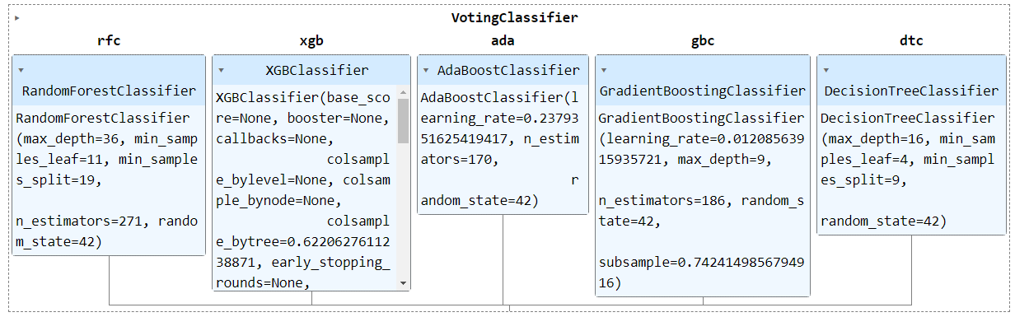
Ensemble Learning: A Strategic Fusion for Enhanced Predictive Power (a lot of trees)
Human Activity Recognition
Classification Label

Slide 36
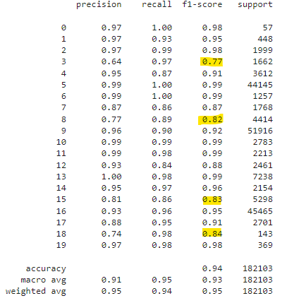
Ensemble Learning: A Strategic Fusion for Enhanced Predictive Power (a lot of trees)
High Accuracy - The model demonstrates an overall accuracy of 94%, indicating a strong ability to correctly classify instances across various classes.
Consistent Precision & Recall - Across the majority of classes, the model showcases high precision and recall rates, suggesting it can reliably identify true positives and minimize false negatives.
Diverse Class Handling - The model effectively handles a wide range of classes, from those with fewer instances to those with tens of thousands, maintaining robust performance metrics.
Challenges with Undersampled Classes - The model's weakest accuracy is observed in classes with fewer samples, highlighting the importance of balanced data for optimal performance. (competition, negotiation, sales, walking meeting)
Macro & Weighted Averages - The macro average, which treats all classes equally, and the weighted average, which considers class imbalances, both reflect high performance, underscoring the model's comprehensive capability.
Takeaway - The ensemble model, optimized using RandomizedSearchCV, demonstrates a well-rounded and reliable classification performance across diverse activity types, with room for improvement in undersampled classes.
Human Activity Recognition

Slide 37
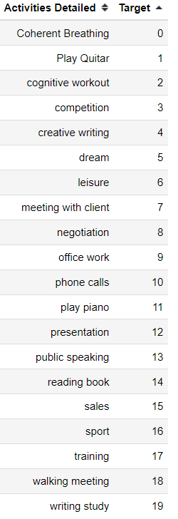
Predictive Labels
Human Activity Recognition
Notes:
Photo by Tima Miroshnichenko: https://www.pexels.com/photo/a-person-holding-a-smartphone-7567228/
From <https://www.pexels.com/photo/a-person-holding-a-smartphone-7567228/>

Slide 38
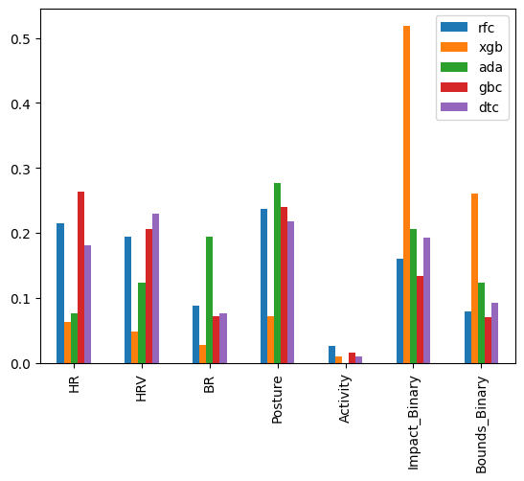
Feature Importances in Ensemble Model
Physiological Metrics Focus: Models like Random Forest and Gradient Boosting place significant emphasis on physiological metrics such as HR and HRV. These features provide a direct insight into the body's response to various activities, making them crucial for accurate activity classification.
Binary Feature Affinity: XGBoost and AdaBoost show a strong inclination towards binary features, especially those like Impact and Bounds. Binary features offer clear decision boundaries, aiding these models in their iterative error correction mechanisms.
Posture & Activity Recognition: Almost all models in the ensemble value the 'Posture' feature. It's a testament to the importance of understanding the user's position in activity classification.
The ensemble approach ensures a harmonious blend of models, each with its unique feature preference. This diversity guarantees that a wide array of features is considered, leading to a comprehensive and robust classification system. By leveraging the strengths of individual models and their feature affinities, we achieve a balanced and well-rounded predictive capability.
Human Activity Recognition

Slide 39
Journey Through Holter Data Insights
1. Data Grouping & Clustering Analysis:
Through rigorous analysis of Holter data, we identified distinct clusters that signify different user activities. This segmentation provided a foundational understanding, setting the stage for predictive modeling.
2. Model Development:
Utilizing a combination of advanced machine learning algorithms, we developed an ensemble model. This approach leverages the strengths of individual classifiers to achieve high predictive accuracy for activity classification.
3. Implications for Holter Devices:
The ability to predict user activities extends the utility of Holter monitors beyond cardiac assessments. It paves the way for comprehensive health monitoring, correlating cardiac data with specific user activities for more nuanced health insights.
4. Future Directions:
While our current model offers promising results, there's potential for further refinement. Future endeavors include integrating real-time AI analytics, enhancing feedback mechanisms, and exploring applications in personalized healthcare solutions.
Human Activity Recognition

Slide 40


THANK YOU!
Contact Details
simona.mircheva@gmail.com
b.r.markov@gmail.com B.Davidov@feb.uni-sofia.bg
Github link
Notes:
https://github.com/a1441/Summer_School_2023/tree/main
GitHub icon by Icons8 <a target="_blank" href="https://icons8.com/icon/4Z2nCrz5iPY2/github">GitHub</a> icon by <a target="_blank" href="https://icons8.com">Icons8</a>
LinkedIn icon by Icons8 <a target="_blank" href="https://icons8.com/icon/8808/linkedin">LinkedIn</a> icon by <a target="_blank" href="https://icons8.com">Icons8</a>

